Slide 1

Game Recommender System
Group 10
Group members
Nguyễn Nhật Minh- 20225510
Tạ Hồ Thành Đạt - 20225482
Ngô Duy Đạt - 20225480
Đới Sỹ Thắng - 20225528
Nguyễn Minh Quân - 20225520
Ha Noi, 30/05/2024

Slide 2
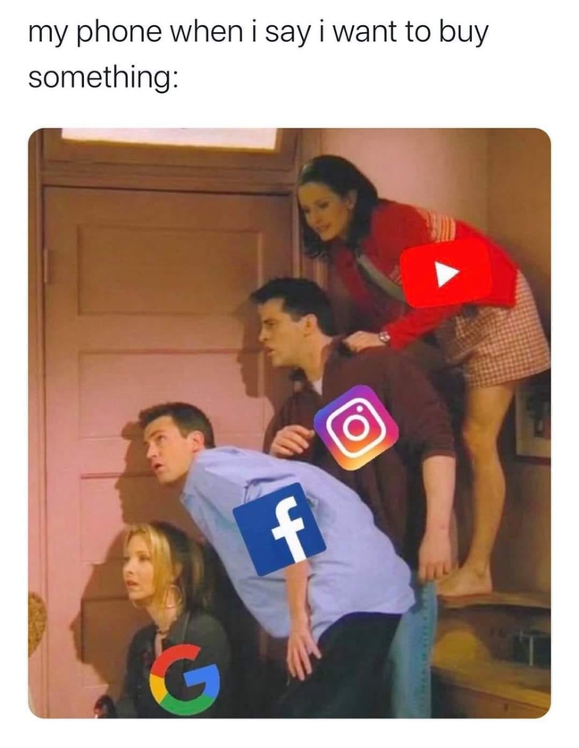

Introduction
Recommender system is long-stading field in Machine Learning, tied to the development of sales industry.
"I liked one cat video, and now my social network thinks I'm the next Tiger King!"
Back to Agenda Page

Slide 3
PROBLEM
LEARNING TASK
Objective: Predict a user's preference for games to provide personalized recommendations.
Type: Can approach through supervised learning with label of rating or unsupervised learning by clustering using similarity between users or items.
Evaluation : For simplicity, we don’t solve cold-start, use hold-out split data into trainset , testset( all users, items available on trainset), employ evaluations metrics like: RMSE, NDCG@5, F1@10.
DATA
Input: interactions data( implicit feedbacks or explicit feedbacks), items data, users data.
Output: A score or ranking indicating the likelihood that a user will enjoy a particular game.
POPULAR CHALLENGES
Sparsity.
Scalability.
Cold-start problem.
Dynamic preferences.

Slide 4
The Dataset
Steam Rating Dataset
The dataset used in this project is derived from the Steam Game Dataset available on Kaggle, for simplicity, we get user >=40 interactions.
The dataset has 4 files:
games.csv : including the basic info of games.
metadata.json : including the descriptions and tags ( genres) of games.
user.csv : including 2 info of users.
recommendations.csv: interactions between users and games and some relational info.
This density of dataset is : 0.15%

Slide 5
The Dataset
Steam Rating Dataset
The initial labels were binary, indicating whether a user recommended the game or not. However, the labels were highly imbalanced.
From the playtime feature and is recommended feature , we propose assumption to convert it into the rating 1 - 5 with step: 0.5.
We put it as explicit feedbacks, and the initial is implicit feedbacks.

Slide 6
Content-based
Filtering
A system that recommends to users products that share similar characteristic with what they like

Slide 7
Data preprocessing
Building games feature vectors
Methodology
Content-based filtering
Training ML Models
Evaluation

Slide 8
1. Reduce the dataset
-> New dataset with 10000 games ,1214 users and
71k ratings
Data Preprocessing
2. Text preprocessing
-Concatenate “tags” and “description” of each game
-Remove number and special characters
-Remove stop words: and, but, or, ...
-Stem words: goes->go, going->go
Content-based filtering

Slide 9
1. Term Frequency(TF)
How many times a word appear within a document
2. Inverse Document Frequency(IDF)
Words that appear in more documents get a lower IDF score, downplaying their importance in any single document.
TF-IDF
Vectorization
Content-based filtering
TF_IDF = TF * IDF
-> This score reflects how important a specific word to
a particular document

Slide 10
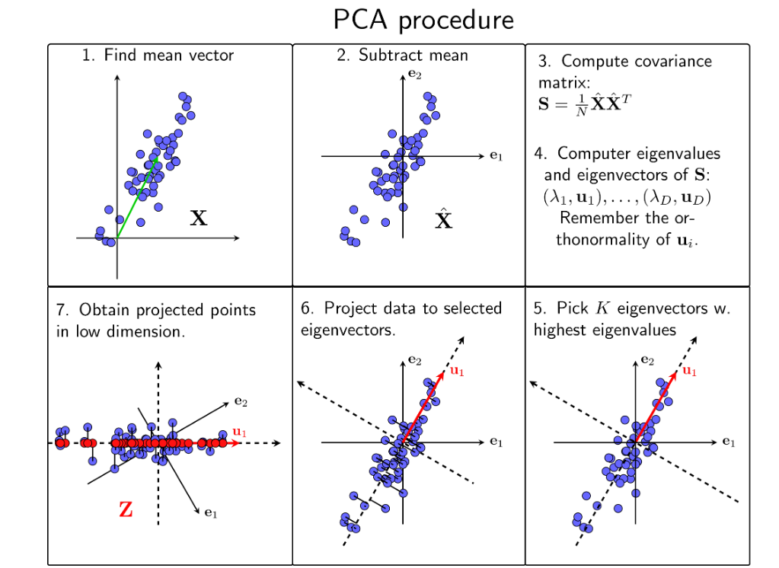
Dimensionality Reduction using PCA
Content-based filtering

Slide 11
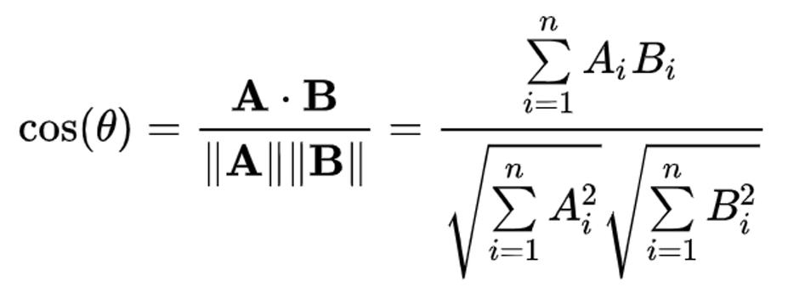
Cosine Similarity KNN
Content-based filtering
Cosine similarity between 2 vectors A and B:
Building cosine similarity matrix
Get top k most similar games to a given game for recommendation

Slide 12
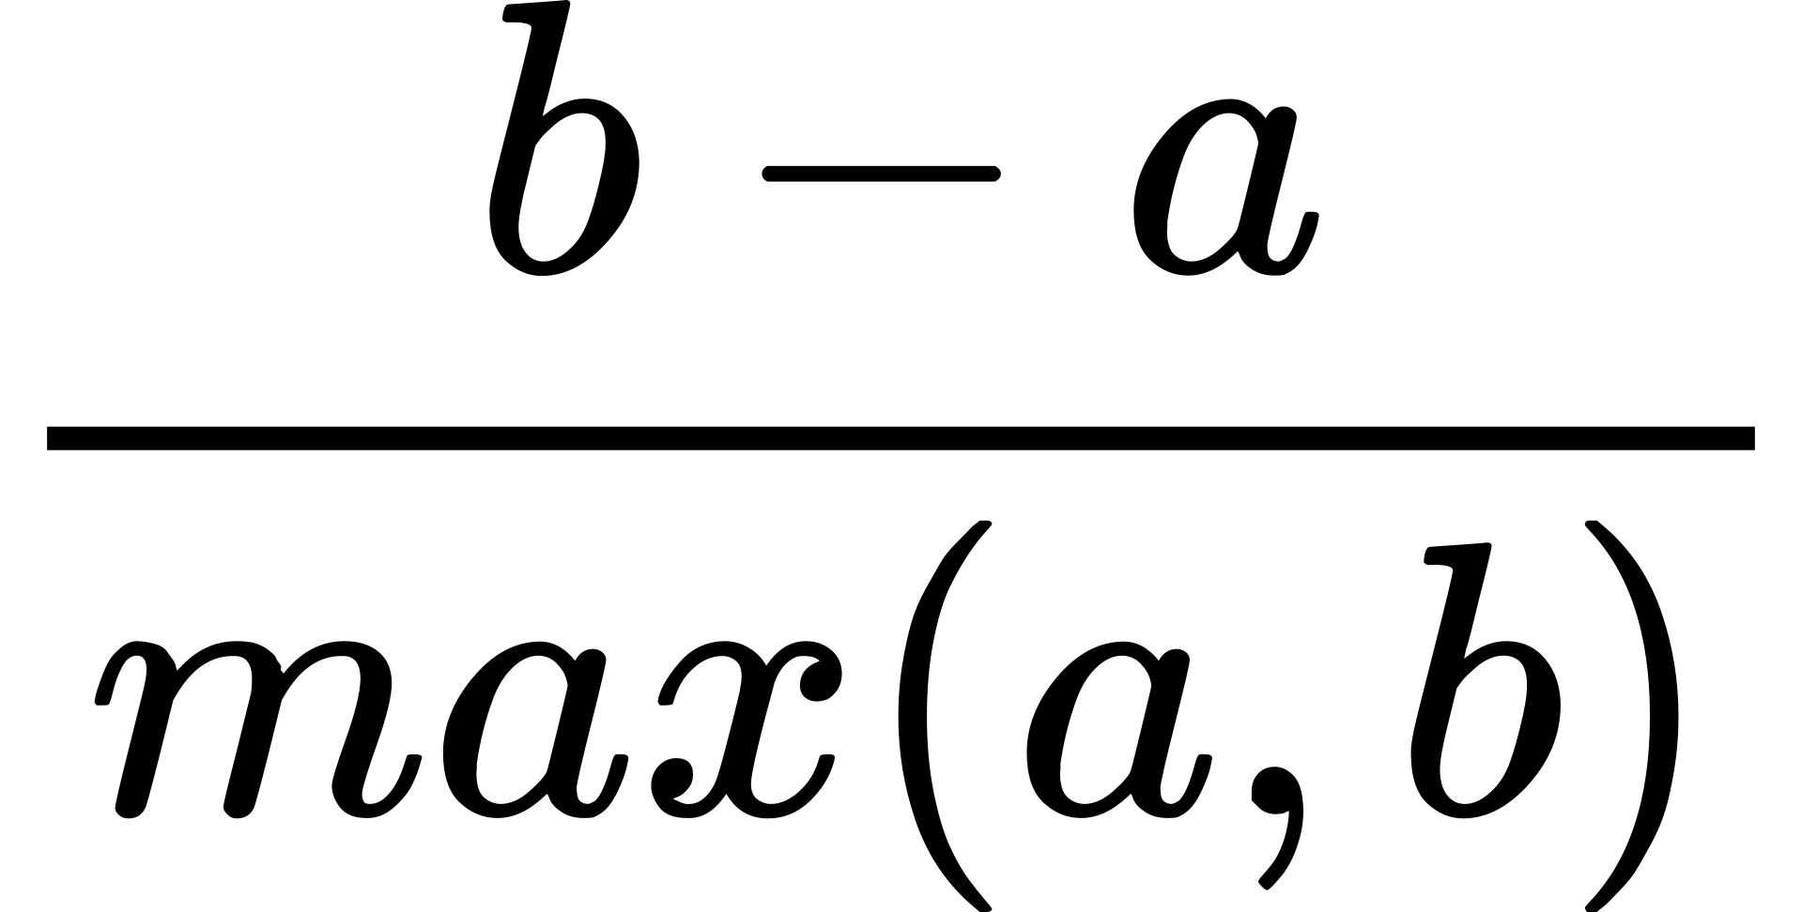
KMeans
Content-based filtering
Sillhouette score: A metric to measure the clustering quality performed by KMeans
a : the average distance between the data point and all other data points within the same cluster
b: the distance between the considered data point to the nearest point but in a different cluster that the data point does not belong to

Slide 13
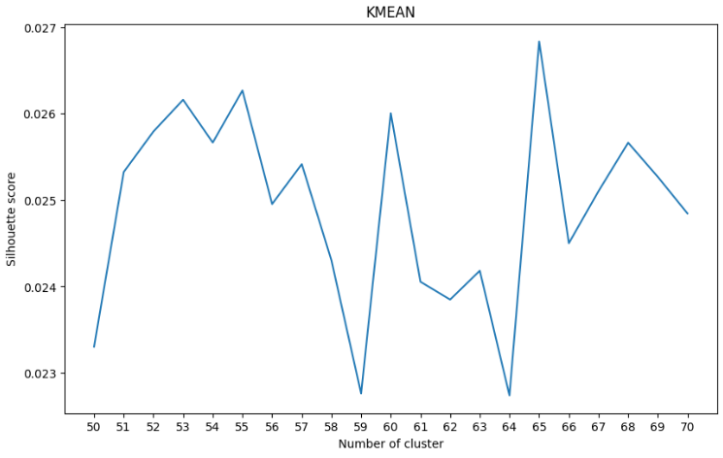
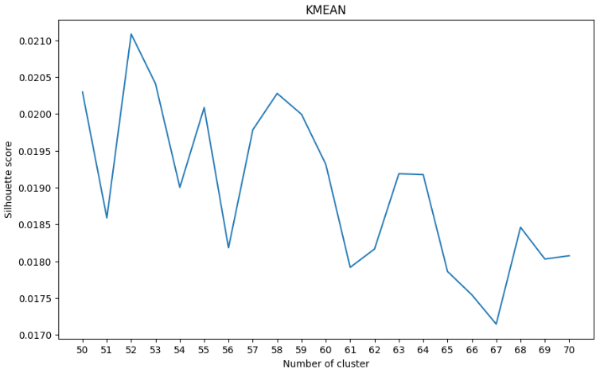
KMeans
Content-based filtering
Silhouette score evaluation with diferent number of cluster
PCA applied
No PCA applied

Slide 14
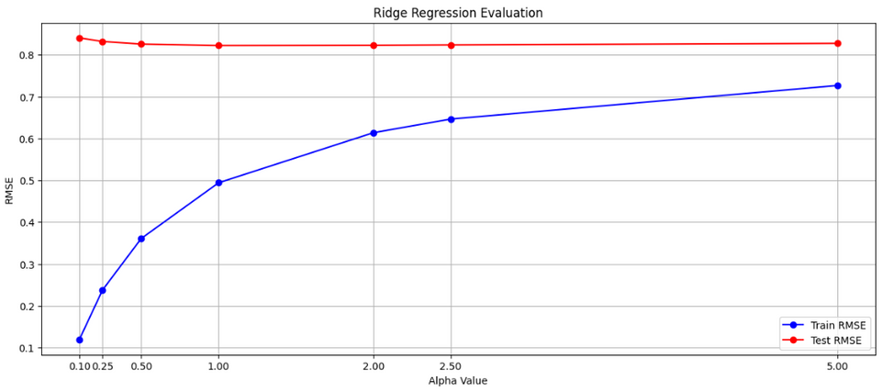
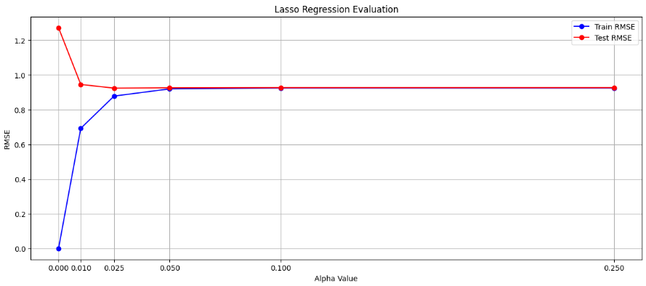
Ridge and Lasso Regression
Content-based filtering
RMSE with điffferent values of alpha
Ridge Regression
Lasso Regression

Slide 15
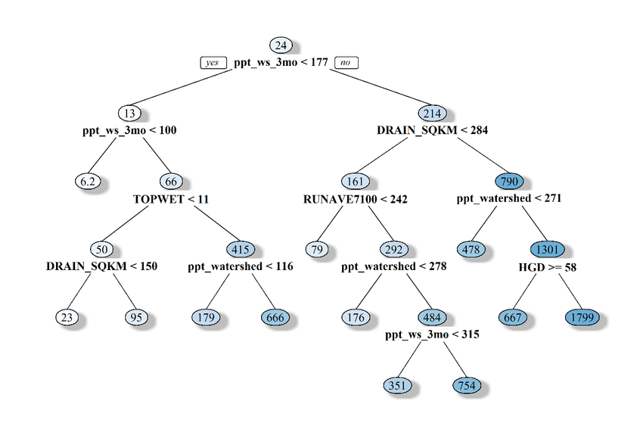
Regression Random Forest
Content-based filtering
An ensemble model involves multiple regression trees to tackle
the weakness of a single tree that is too prone to overfitting
Regression Tree:
Each node partitions the data into 2 subsets based on a feature that best minimize RMSE
Prediction is the average of target values of samples in a leaf

Slide 16
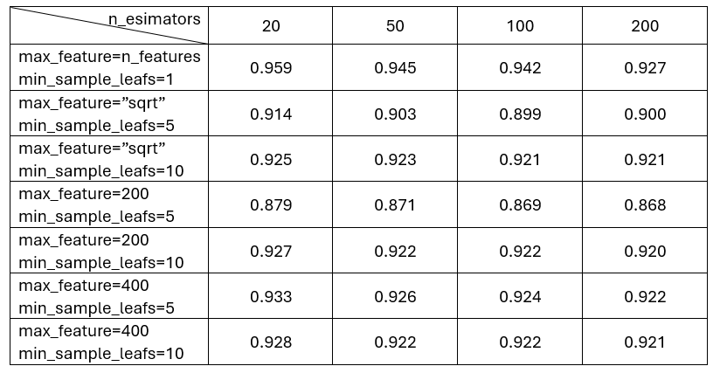
Regression Random Forest
Content-based filtering

Slide 17
Collaborative
Filtering

Slide 18
Neighborhood based
Collaborative filtering
Recommendations based on preferences of similar players.

Slide 19
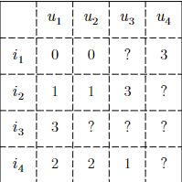
Utility matrix
Collaborative filtering
CF focuses on filling the missing ratings (marked by ?) in the users-items matrix
Recommendations are given based on predicted rating

Slide 20
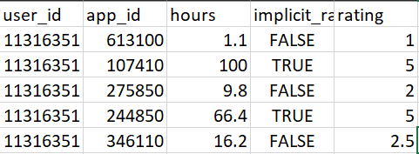
1. Reduce the dataset
New dataset with more than 2 million ratings from nearly 60000 players due to the system’s limitations.
2. Preprocessing
New ratings interval infered from users’ play times and implicit ratings (recommended or not recommended).
Input data
Neiborgh based CF

Slide 21
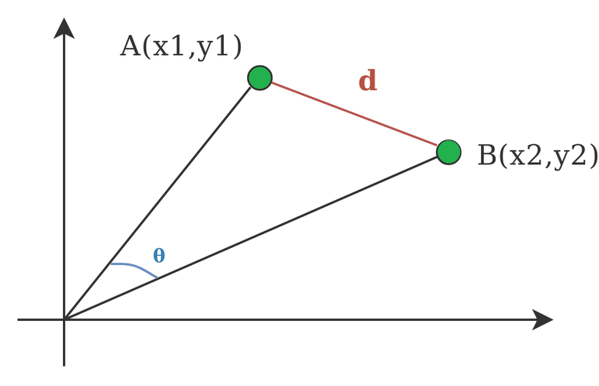
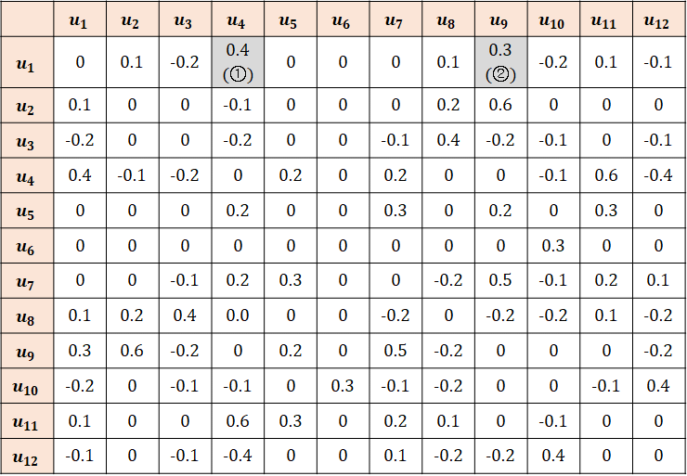
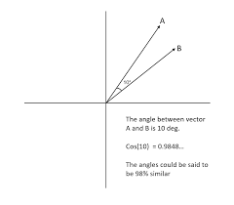
Similarity functions
Collaborative filtering
A simlilarity matrix of all users can be constructed given the similarity functions

Slide 22
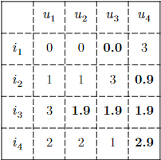
Prediction
Neighbor based

Slide 23
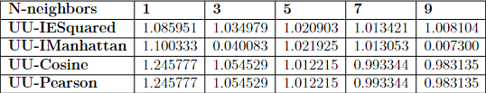
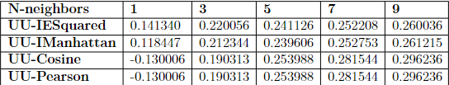
Evaluation
Neighbor based
RMSE
R2-score

Slide 24
Latent factor
Collaborative filtering
Recommendations based on finding hidden factors.

Slide 25
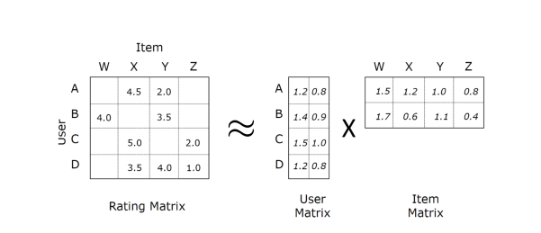
Matrix Factorization
Matrix Factorization without SideInfo
Decompose the Rating matrix(mxn) into 2 low-rank matrices (User matrix (mxk)- Item matrix(kxn))
--> k represents the number of latent factors( can be the genre of games, demographic of user, or somthing else that model can find.
Based on this idea and how to define “approximate” , some algorithms are proposed:
SVD, SVD++, ALS, NMF.

Slide 26

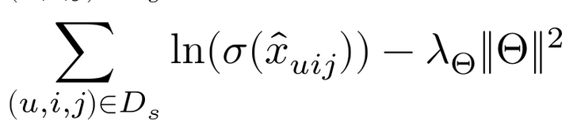
Matrix Factorization
Matrix Factorization without SideInfo
Bayesiian Personal Raninking MF(BPR-MF)
This model is designed to handle the implicit feedback for personalized recommendations.
Aims to optimize the ordering of items for each user, rather than predicting absolute ratings.
It maximize the posteriors:
The final formulation need to minimize:

Slide 27

Matrix Factorization
Matrix Factorization SideInfo
Collective matrix factoirzation(CMF) is advanced method in matrix factoization by relational learning
Unlike traditional matrix factorization, which deals with a single matrix at a time, CMF integrates information from multiple matrices, capturing the dependencies and interactions among different types of entities.
Other formulations in CMF also proposed in the project:

Slide 28
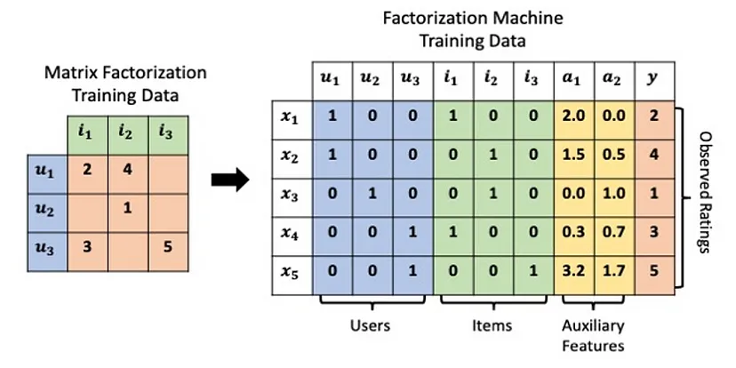
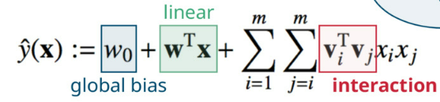
Factorization Machines
Are powerful predictive modelling techniques especially designed to handle sparse and high-dimensional data, which is typical feature in recommender system.
FM are proposed as a new model that combines the polynomial SVM with factorization model.
Factorization machines can estimate interactions even in sparsity well because they break the independence of the interaction parameters by factorizing them

Slide 29
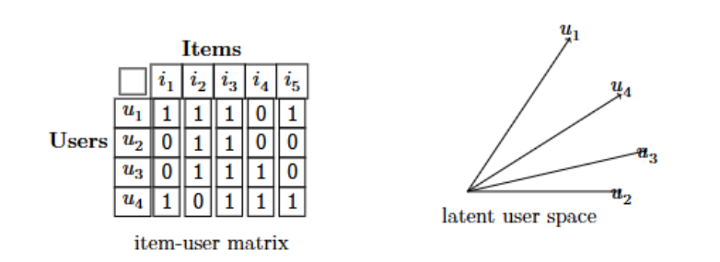
Deep Learning Approach
Collaborative filtering
Limitation of MF
There is a conflict where U4 is closest to U1 , U1 also second near with U2 , but U4 is more difference with U2

Slide 30
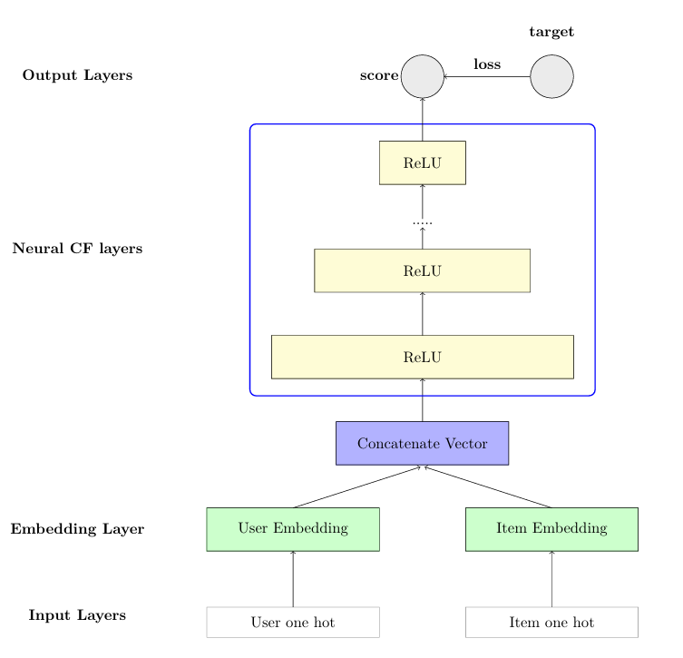

Deep Learning Approach
Collaborative filtering
Neural Collaborative Frame work
Learning the latent factor of the user and item in the non-linear kernel, instead of the linear kernel in matrix factorization

Slide 31
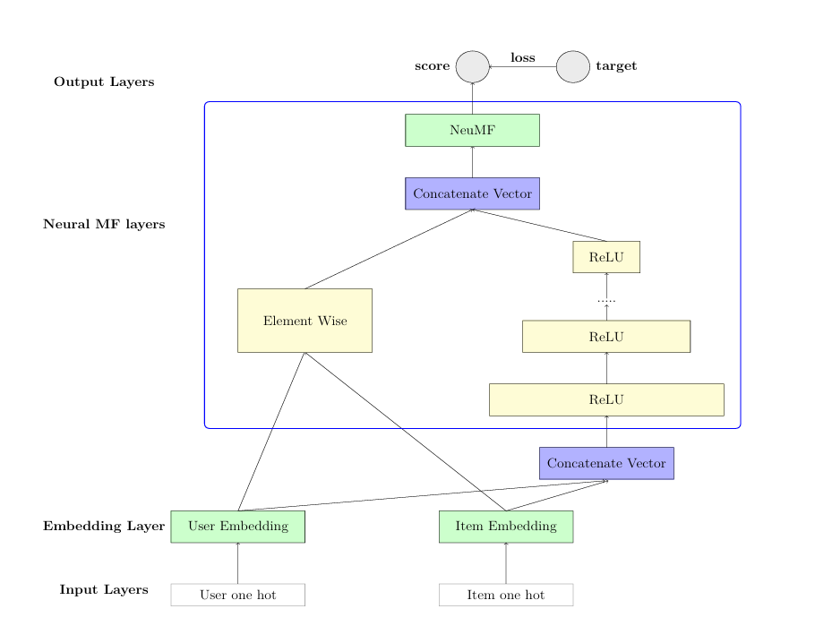


Deep Learning Approach
Collaborative filtering
Neural Matrix Factorization

Slide 32
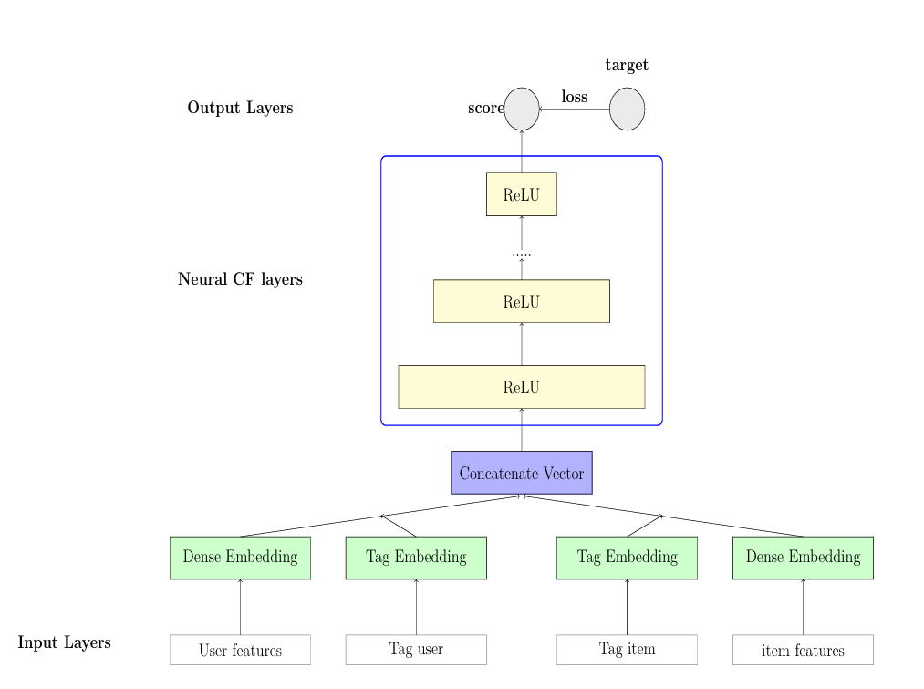

Deep Learning Approach
Collaborative filtering
Neural collaboration with feature
Embedding continuous features by linear weighted matrix
Embedding categorical features by matrix embedding
Learning interaction of user and item Multi-layer Perceptron

Slide 33
Thank you!
Do you have any questions?

